Slide 1



MUZIX
APPLICATION

Slide 2
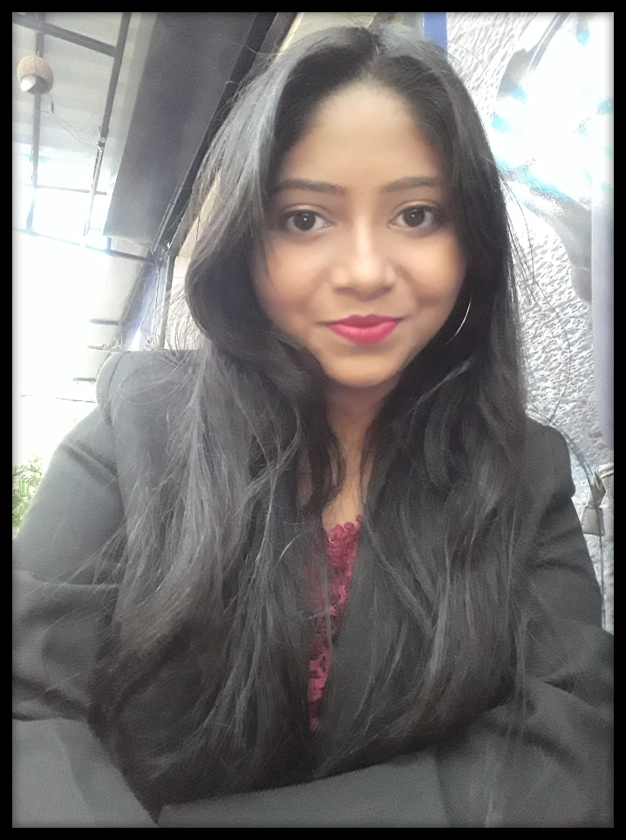
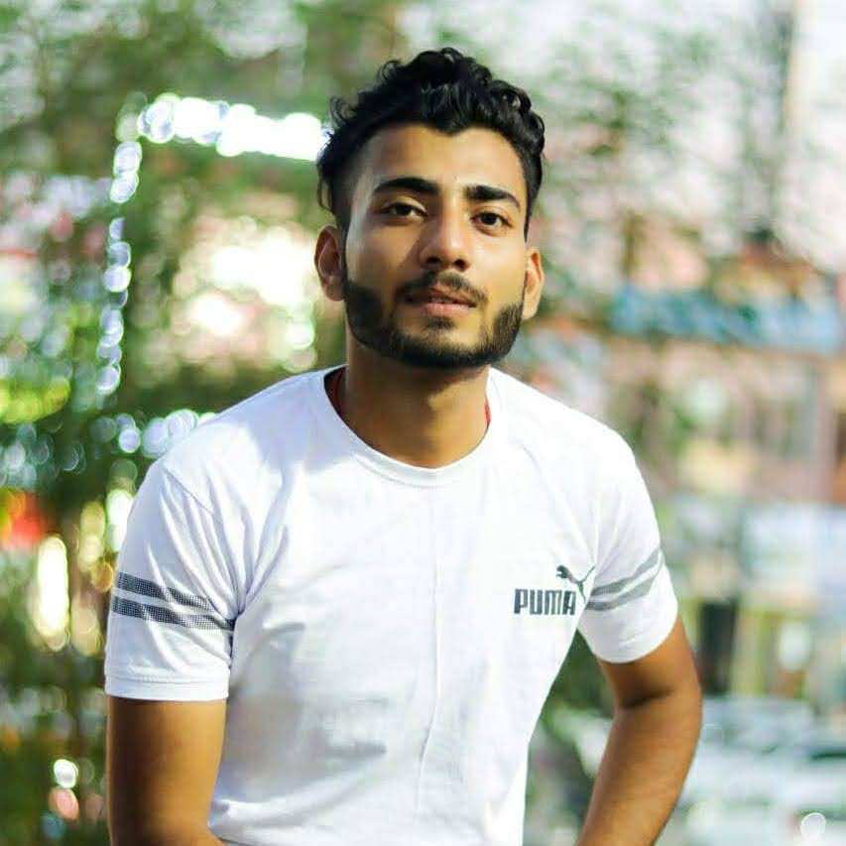
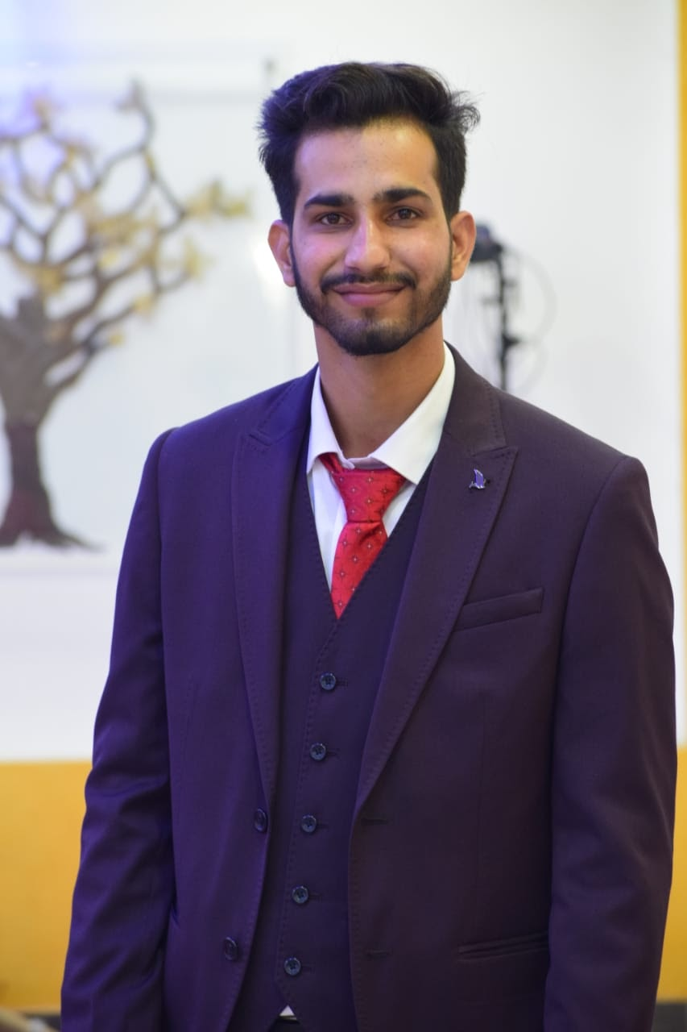
Our Team Members-
Utkarsh Chaudhary
Rishita Saha
Shivansh Bohra

Slide 3
INTRODUCTION
Our Major Project is Muzix Application.
In our application a registered user can make multiple profiles and enjoy movies.
It has the facility to search movies as per the requirement on the basis of language, rating, and genre.
This app uses a 3rd party API to fetch movies.
This app is compatible with all devices like tablets, Mobile, Desktops, Smart TVs, etc.

Slide 4
BENEFITS
Convenience:- Our Muzix application offers the convenience of being able to watch movies anytime, anywhere with an internet connection.
Time Efficient:- It gives one platform to browse through all movies and choose any by personalized criteria and watch them.
Flexibility: Movie websites offer the flexibility to watch movies on different devices and at your own pace.
Customize Playlist: Add any movie you want to watch later or rewatch to your favorite list.

Slide 5
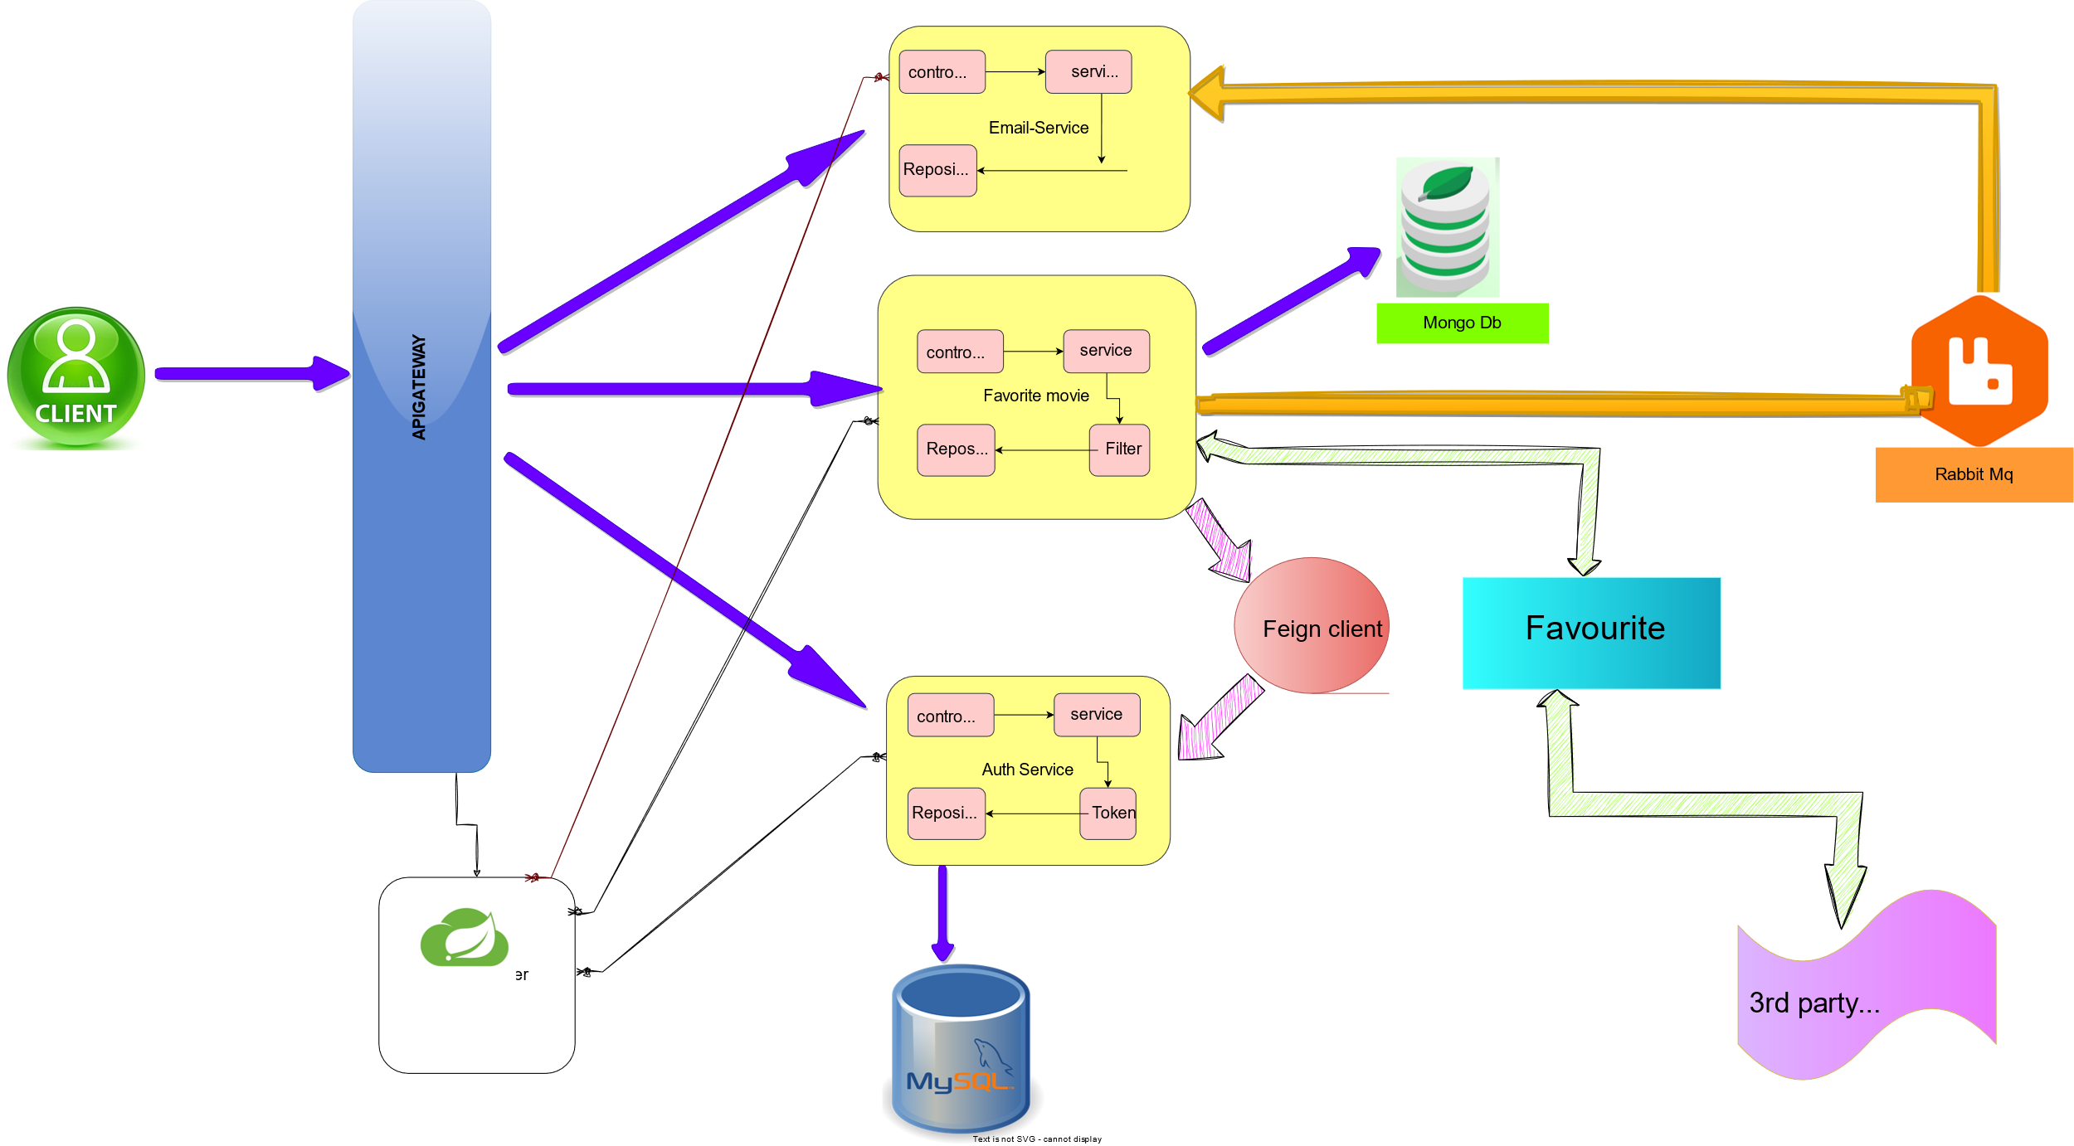
ARCHITECTURE BACKEND
TMDB
Eureka

Slide 6
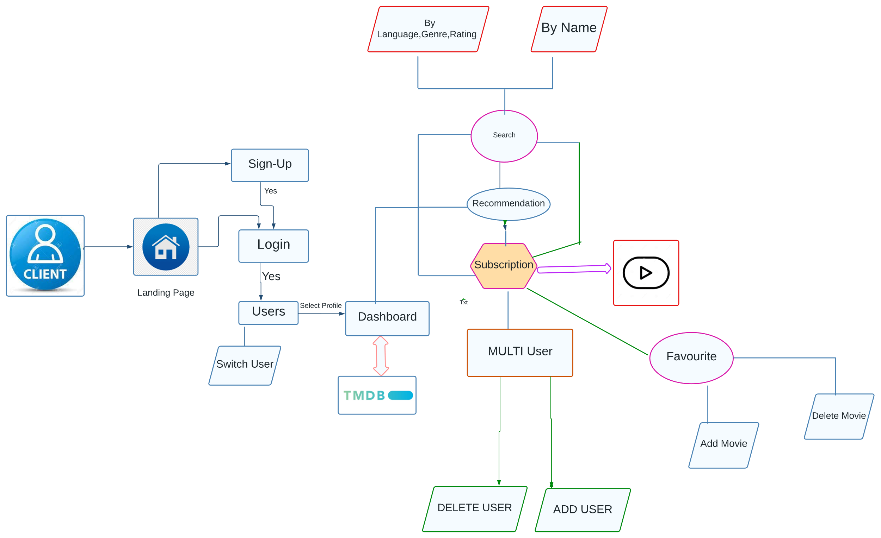
FLOWCHART

Slide 7


TOOLS & TECHNOLOGIES
Database
2. Mongo Db
1.MySql

Slide 8






TOOLS & TECHNOLOGIES
Backend
1. Spring Boot
2. Eureka Server
3. API Gateway
4.Feign Client
5.Java
6.Rabbit MQ
7. JWT Token
8.Docker

Slide 9






TOOLS & TECHNOLOGIES
Frontend
Angular
2. Type Script
3. Boot Strap
4.HTML,CSS,JS
5.TMDB
6.Angular-Material

Slide 10
FEATURES
Successfully verified registered users can have multiple profiles.
Browse movie information and enjoy any movie trailer.
Search Movies- Can search movies on rating, language, genre, and name basis.
Users can add and delete any movie from their customized favorite list.
Get Recommended movies on basis of your searched movies.

Slide 11
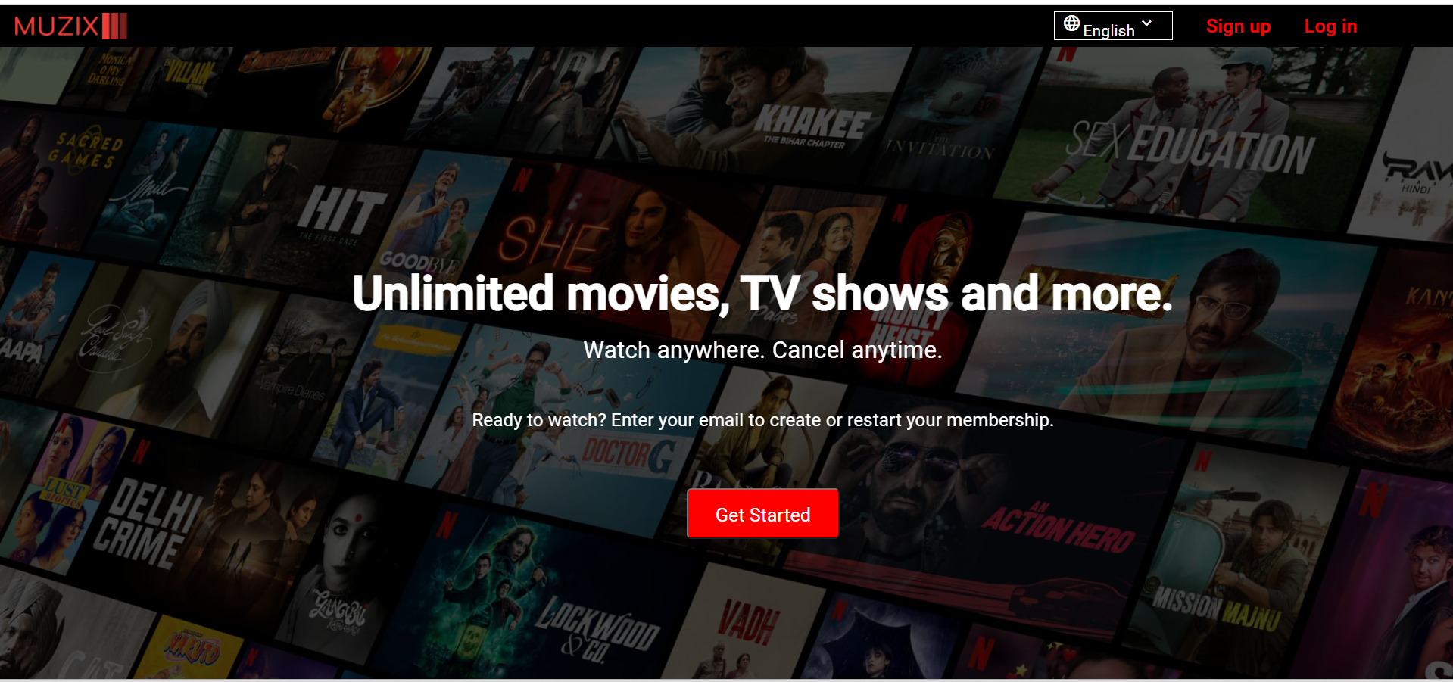
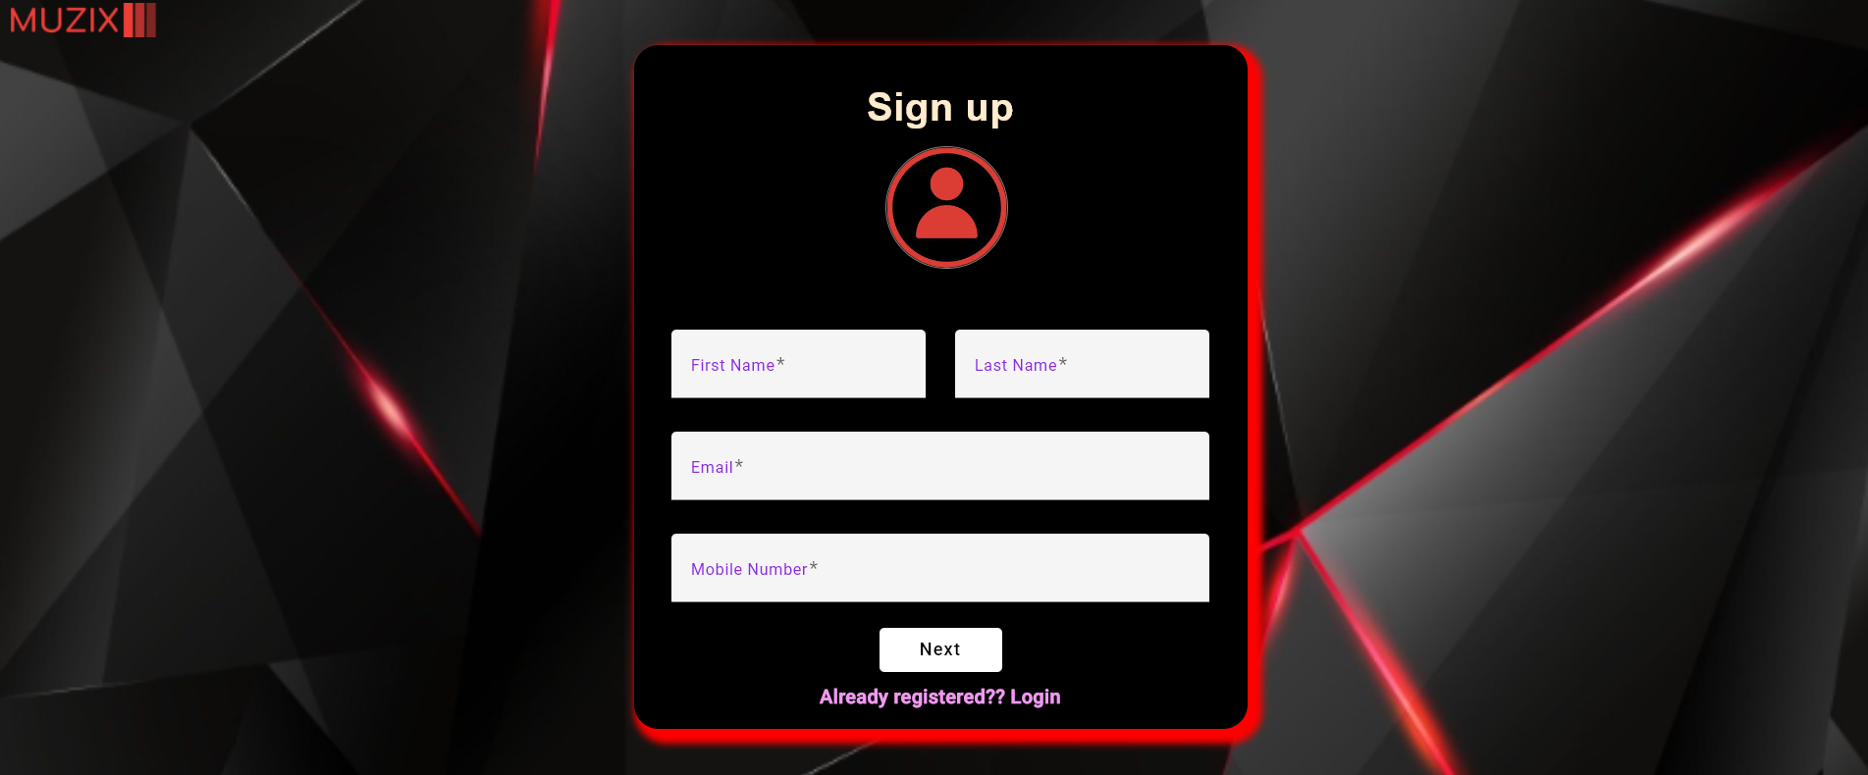
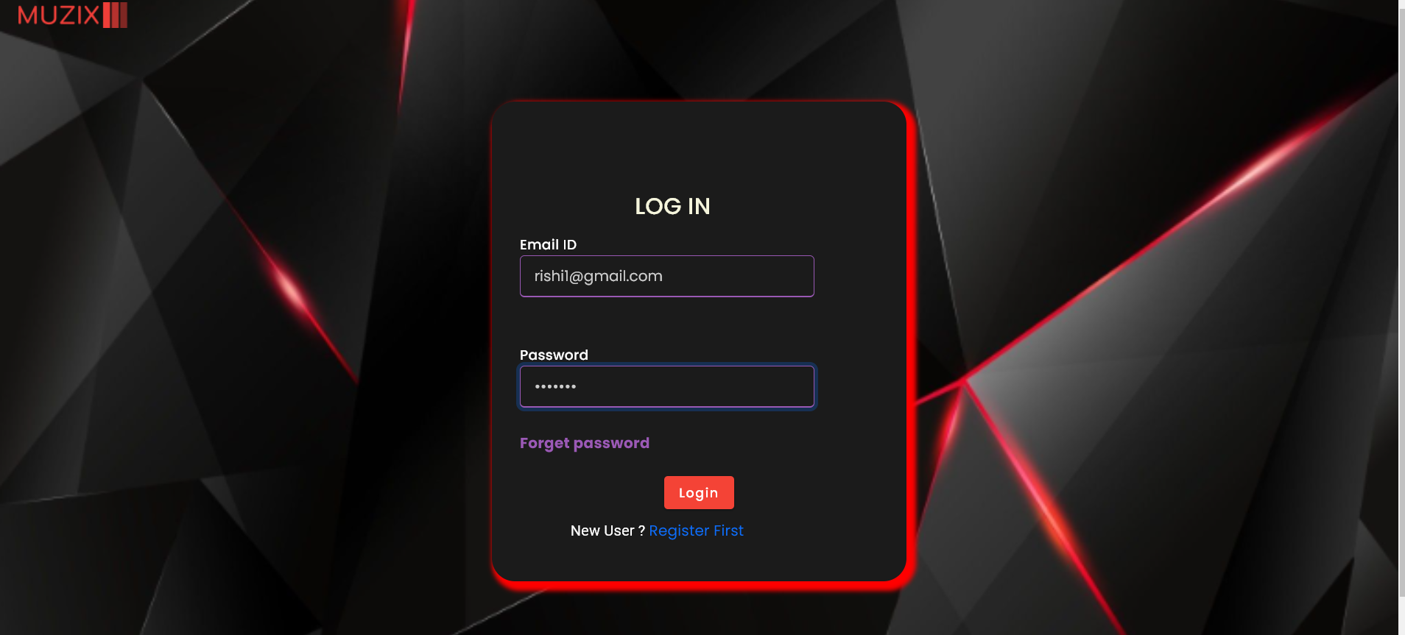
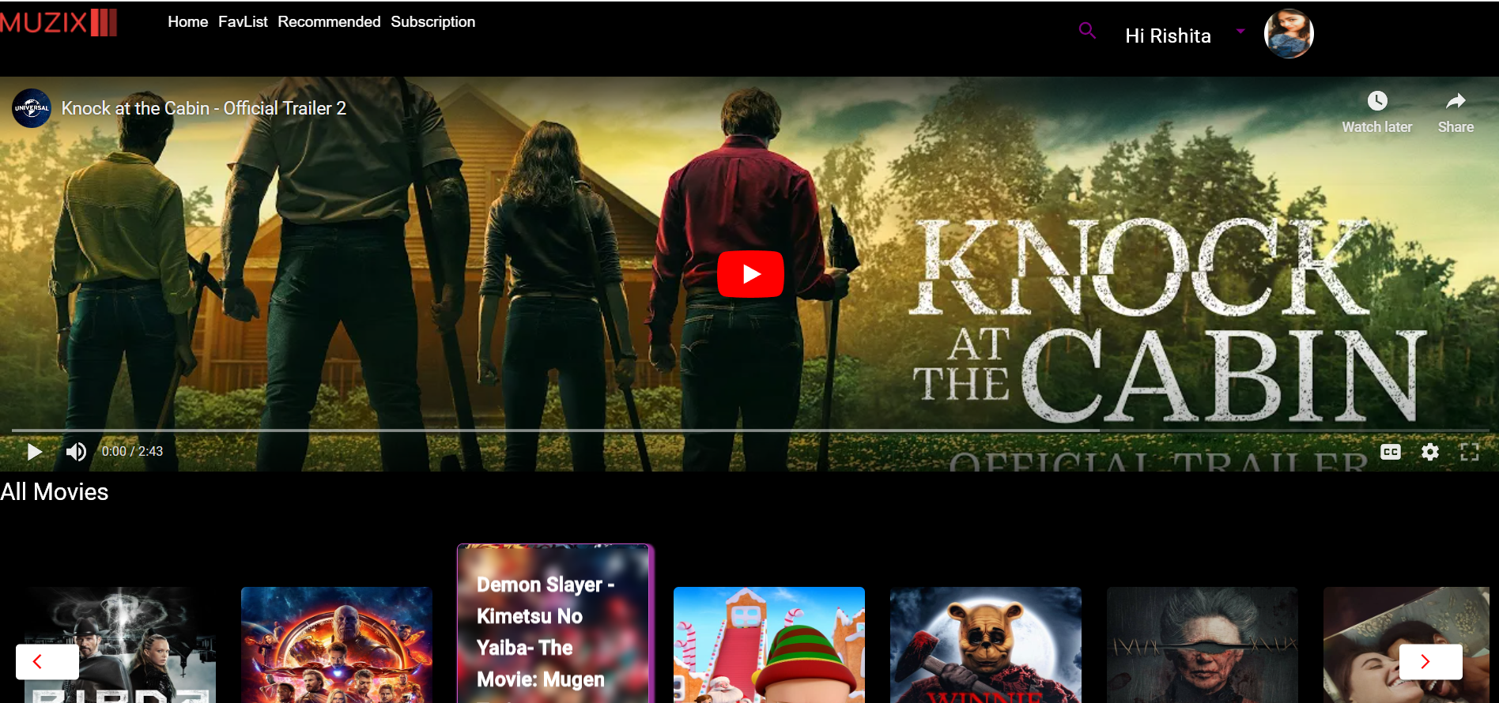
INTERACTIVE DEMO
Landing Page
Sign up
Landing Page
Signup Portal
Login
Login Portal
Dashboard

Slide 12
Question And Answers

Slide 13
FUTURE ENHANCEMENT
We would like to make our project multilingual, so it can be browsed with any language.
Update user can be implemented.
Live broadcasts like sports, and news.
Make personalized advertising.

Slide 14
Thank You

